Slide 1

Holiday Promotion Optimization

Slide 2
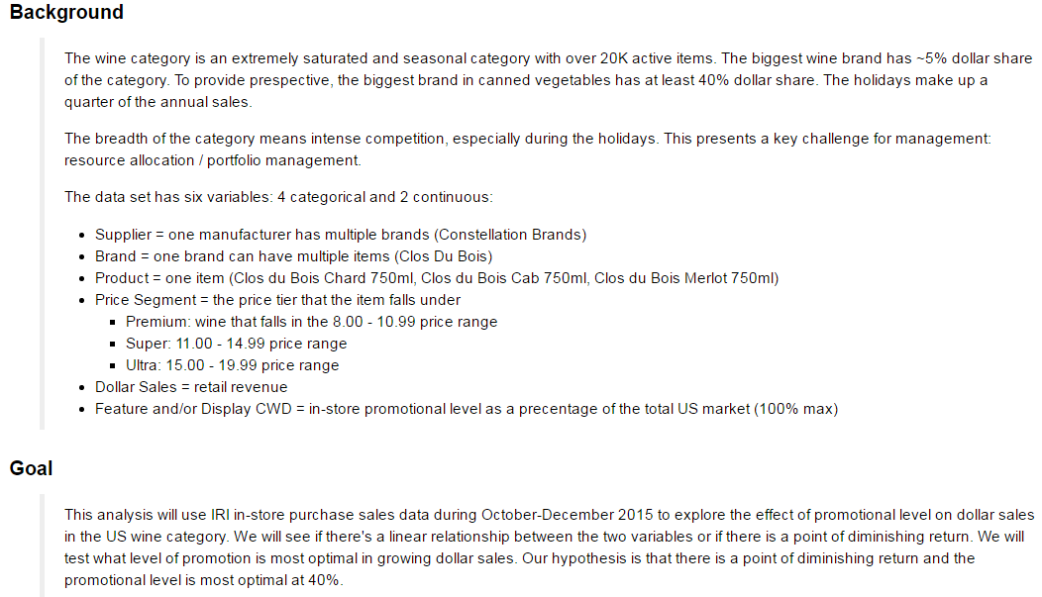
Project Background & Goal
Notes:
1 Outline Slide
What is your project about?
What is its history?
What relevant information is required for a colleague to jump in to understand your project?

Slide 3
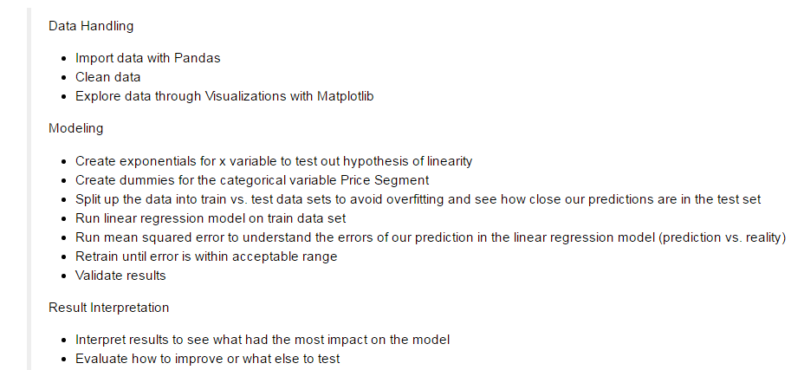
Project Steps
Notes:
2-3 Summary Slides (including data and problem statement)
What were you trying to accomplish?
What steps did your project take?
Where did the data come from? What does a sample look like? Was there data you considered but decided to remove?

Slide 4
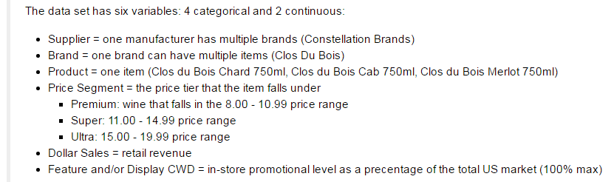
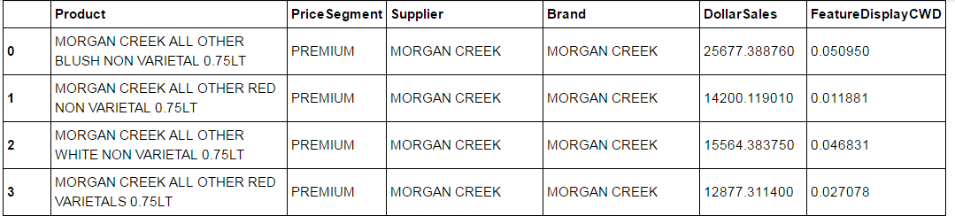
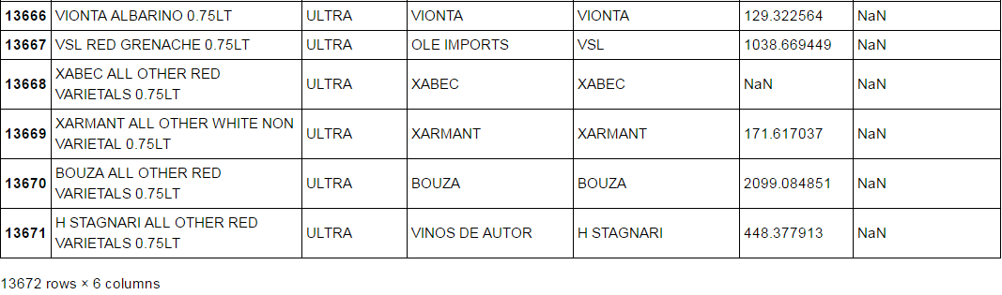
Project Data Description
Notes:
2-3 Summary Slides (including data and problem statement)
What were you trying to accomplish?
What steps did your project take?
Where did the data come from? What does a sample look like? Was there data you considered but decided to remove?

Slide 5

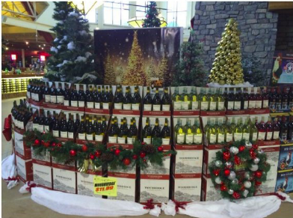
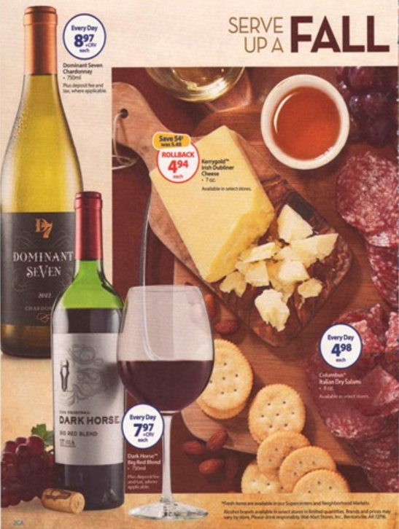
Examples | Product | Promotion Vehicles
Display
Feature
a brand portfolio example:
-chard
-pinott grigio
-sauvignon blanc
-cabernet sauvignon
-merlot
-pinot noir
-cabernet sauvignon reserve
-merlot reserve
-zinfindal reserve

Slide 6
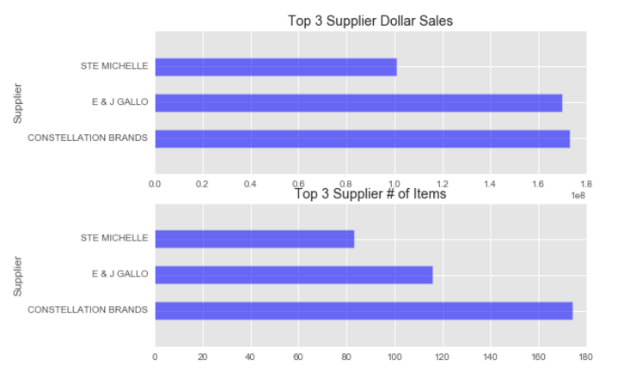
Data Visualization | Top 3 Suppliers
Constellation and Gallo have similar dollar sales, but Constellation has ~60 more items than Gallo
This proves that holiday is immensely competitive during the holidays; we are at a disadvantage with higher item count in terms of resource allocation and portfolio management
Notes:
3-4 Modeling Insight Slides
What is the visualization explaining?
What do the x and y axes mean?
How does the visualization help either prove or disprove your work?
What caveats have to be explained to best understand it?

Slide 7
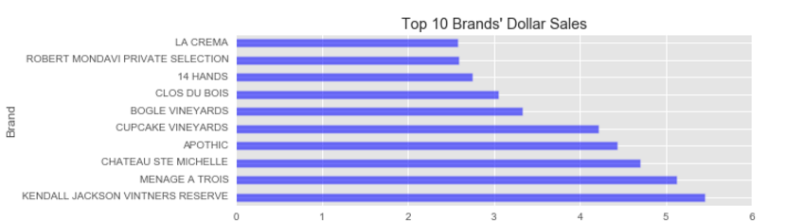
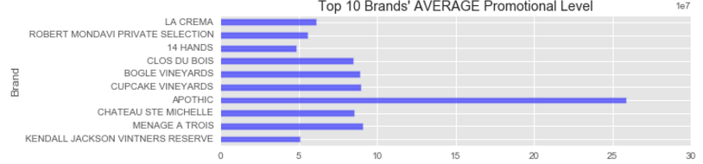
Data Visualization | Top 10 Brands
With the exception of Apothic, the top ten selling brands’ average promotional level of less than 10%
If 10% is all it takes, we don’t need this analysis! Lets drill down into the 10% to see why it’s so low…
Notes:
3-4 Modeling Insight Slides
What is the visualization explaining?
What do the x and y axes mean?
How does the visualization help either prove or disprove your work?
What caveats have to be explained to best understand it?

Slide 8
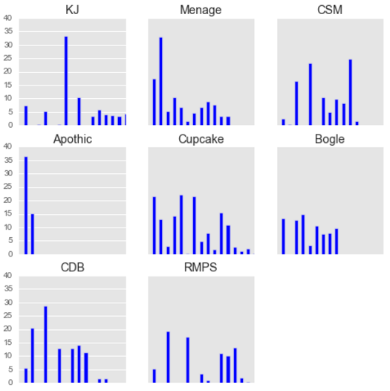
Data Visualization | Promotional Level by Item
The total brand’s average promotional level was pulled down by other items’ lower promotional level
Most brands have at least one item with high promotional level
Promotional Level
Item
Notes:
3-4 Modeling Insight Slides
What is the visualization explaining?
What do the x and y axes mean?
How does the visualization help either prove or disprove your work?
What caveats have to be explained to best understand it?

Slide 9
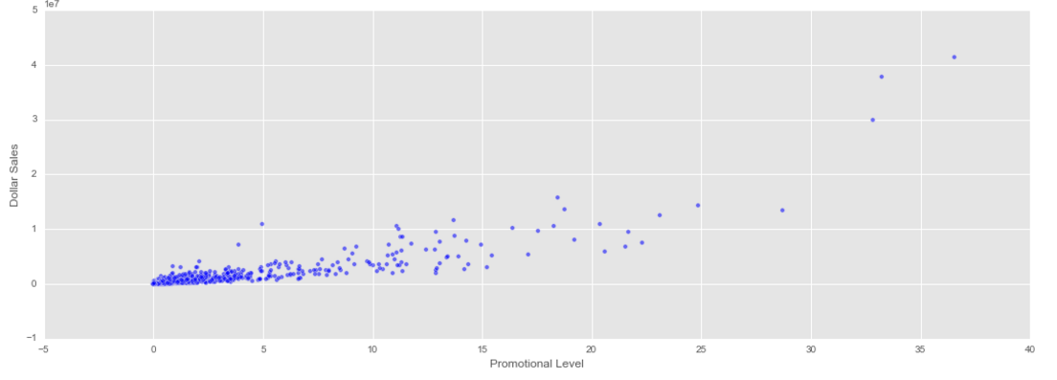
Data Visualization | Dollar Sales & Promotional Level
Different vs. expectation of a diminishing return curve:
Notes:
3-4 Modeling Insight Slides
What is the visualization explaining?
What do the x and y axes mean?
How does the visualization help either prove or disprove your work?
What caveats have to be explained to best understand it?

Slide 10
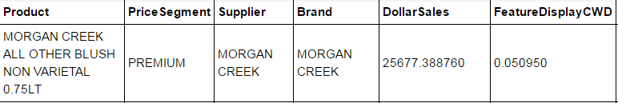
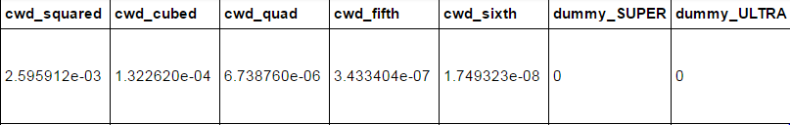
Modeling Approach | Tailoring the Analysis
Keep all data points to include high performers’ behavior
Create exponentials of the promotion variable to include in the regression to see if the effect is linear
promotional level ^ 2 up to promotional level ^ 6
Create dummies for price segment variable to understand the effect of price tiers on dollar sales
Premium: $8.00 - 10.99 price range
Super: $11.00 - 14.99 price range
Ultra: $15.00 - 19.99 price range
Original data set
+
Newly created variables
Notes:
2-3 Modeling Approach Slides
What was your model trying to optimize for? Why was it the right metric for optimization?
What algorithm did you try? How does it work?

Slide 11
Modeling Approach | Regression Model on Train Data Set
Split data into train vs. test sets to avoid overfitting and see how close our predictions are
Run linear regression model on train data set
model = sm.OLS(y, X).fit()
Run mean squared error to understand the errors of our prediction in the linear regression model prediction vs. reality
All data points:
Outliers removed:
R squared: 0.903
Train: $379,851 error vs. $212,947 mean
Test: $374,525 error vs. $226,679 mean
R squared: 0.47
Train: $52,724 error vs. $34,815 mean
Test: $55,085 error
coefficient = 7.0108e+5 * cwd - 1.719e+5 * (cwd ** 2) + 2.853e+4 * (cwd ** 3) - 1911.8322 * (cwd ** 4) + 55.4037 * (cwd ** 5)
Notes:
2-3 Modeling Approach Slides
What was your model trying to optimize for? Why was it the right metric for optimization?
What algorithm did you try? How does it work?

Slide 12
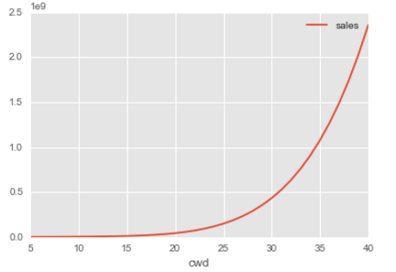
Results | High Breakthrough Point
Contradictory to our hypothesis, promotion has an exponential effect on dollar sales once it reaches 25%
The optimal point with greatest dollar sales increase is ~30%
There is definitely a relationship between sales and promotional level
5% to 40% promotional level
Legend
x = promotional level
y = dollar sales in 1e9
Notes:
2-3 Results Slides
What worked? What didn't? Why?
1-2 Conclusion Slides
What had the most impact on your work?
What can you confirm? What can you suggest? What is still to be determined?

Slide 13
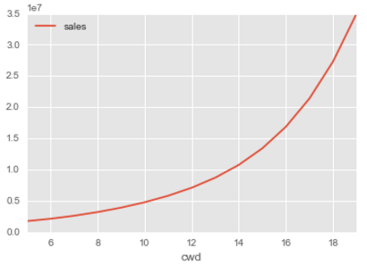
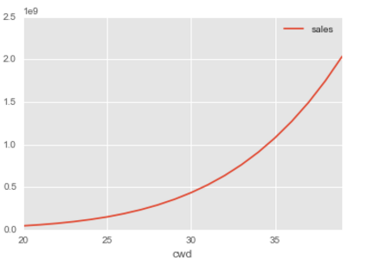
Results | Low vs High Range
5% to 20% promotional level
20% to 40% promotional level
Legend
x = promotional level
y = dollar sales
Note different scale
Notes:
2-3 Results Slides
What worked? What didn't? Why?
1-2 Conclusion Slides
What had the most impact on your work?
What can you confirm? What can you suggest? What is still to be determined?

Slide 14
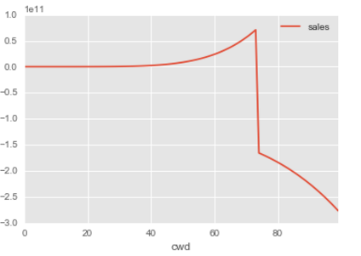
Results | Diminishing Return?
Expanded range from 0 to 100
Negative sales return once promotional level passes 67% … is this possible?
0% to 100% promotional level
Legend
x = promotional level
y = dollar sales in 1e11
Notes:
2-3 Results Slides
What worked? What didn't? Why?
1-2 Conclusion Slides
What had the most impact on your work?
What can you confirm? What can you suggest? What is still to be determined?

Slide 15
Next Steps
Figure out previous slide
Spline regression to look at the effects for the outliers and non-outliers
Evaluate more measures (distribution, price)
One day … cross elasticity to see how changes on one item impact another item
Notes:
2-3 Results Slides
What worked? What didn't? Why?
1-2 Conclusion Slides
What had the most impact on your work?
What can you confirm? What can you suggest? What is still to be determined?
1-2 Next Steps Slides
What should this project do moving forward?
What would be the next two or three things you want to try? What impact might they have?
What might your conclusions enable others to do?

Slide 16









Thank You

Slide 17
Appendix
Project Outline
A 10 to 20 slide deck consisting of:
1 Outline Slide
What is your project about?
What is its history?
What relevant information is required for a colleague to jump in to understand your project?
2-3 Summary Slides (including data and problem statement)
What were you trying to accomplish?
What steps did your project take?
Where did the data come from? What does a sample look like? Was there data you considered but decided to remove?
3-4 Modeling Insight Slides
What is the visualization explaining?
What do the x and y axes mean?
How does the visualization help either prove or disprove your work?
What caveats have to be explained to best understand it?
2-3 Modeling Approach Slides
What was your model trying to optimize for? Why was it the right metric for optimization?
What algorithm did you try? How does it work?
2-3 Results Slides
What worked? What didn't? Why?
1-2 Conclusion Slides
What had the most impact on your work?
What can you confirm? What can you suggest? What is still to be determined?
1-2 Next Steps Slides
What should this project do moving forward?
What would be the next two or three things you want to try? What impact might they have?
What might your conclusions enable others to do?
Bonus:
An Acknowledgements Slide is always a good idea. :)
You might also include a Citations Slide, if necessary

